Slide 1
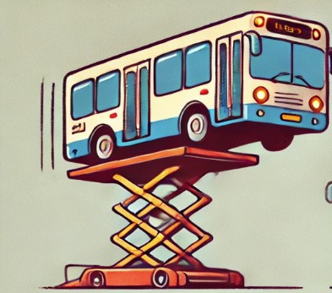
The Bus Is Up

Slide 2
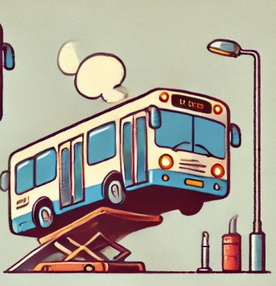
The Bus Is On

Slide 3
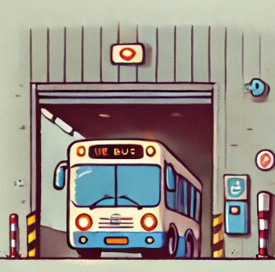
The Bus Is In

Slide 4
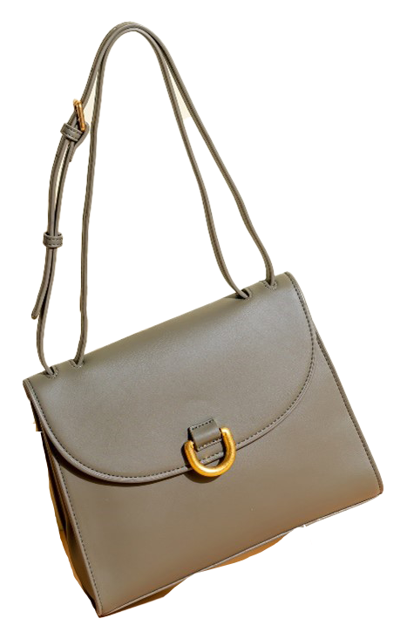
The Bag Is Up

Slide 5
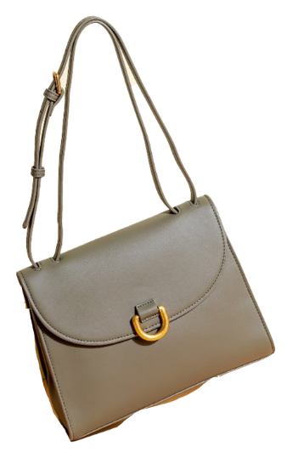
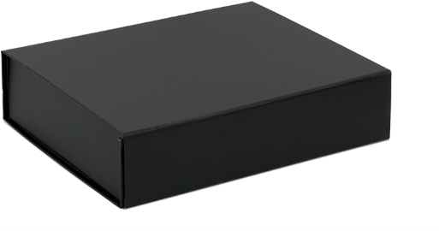
The Bag Is On

Slide 6
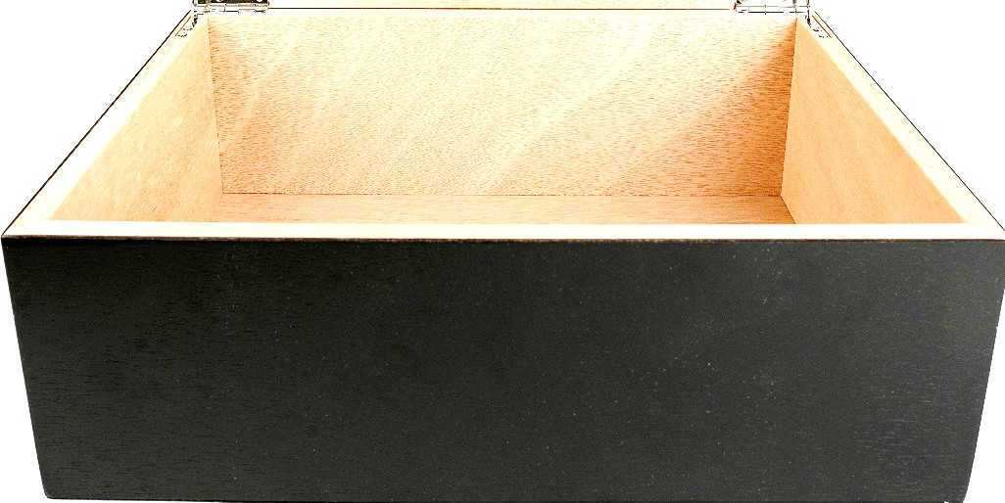
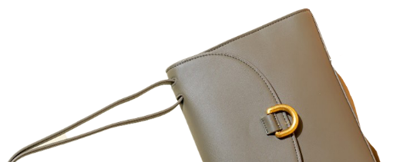
The Bag Is In

Slide 7
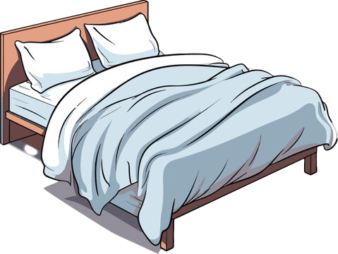
The Bed Is Up

Slide 8
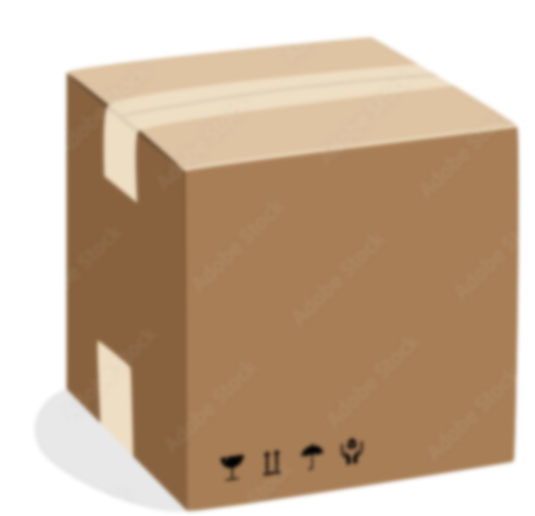
The Bed Is On

Slide 9
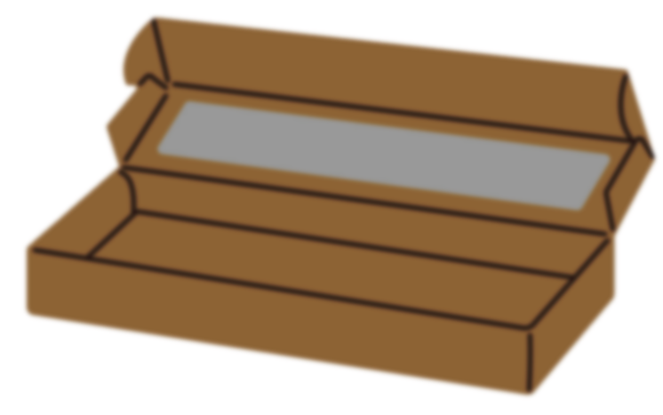

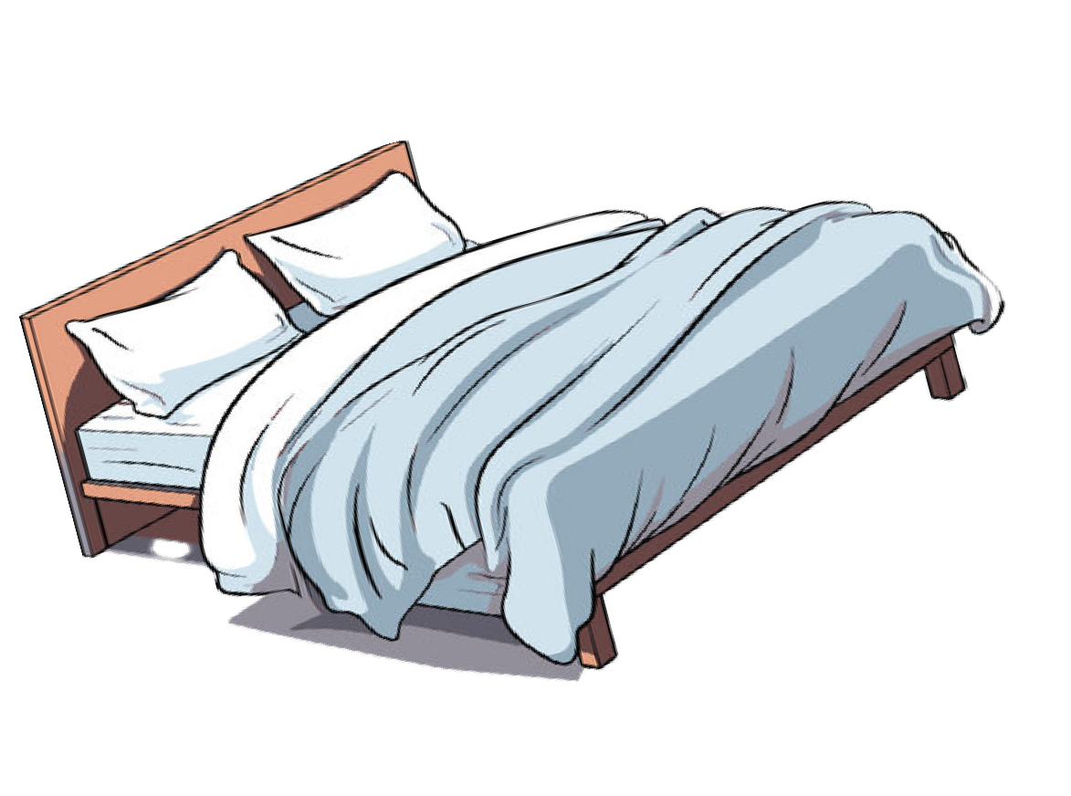



The Bed Is In

Slide 10





The Cat Is Up

Slide 11
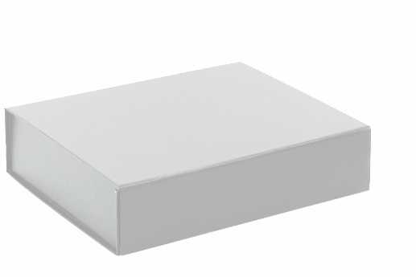


The Cat Is On

Slide 12
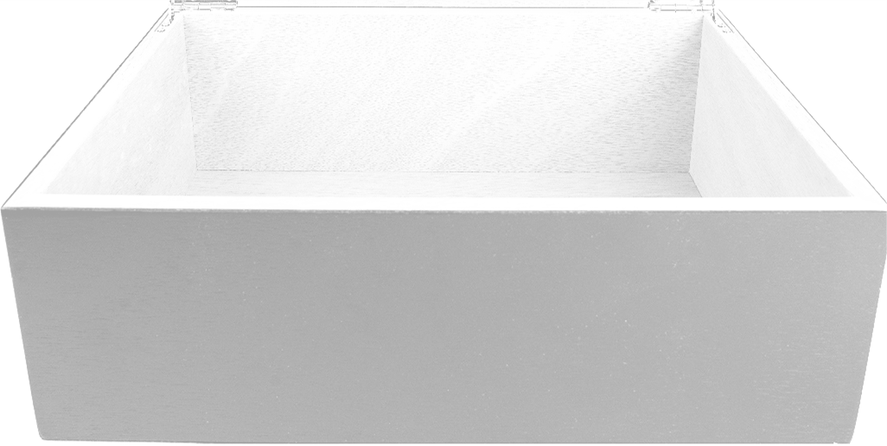

The Cat Is In

Slide 13
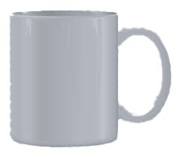
The Cup Is Up

Slide 14
The Cup Is On

Slide 15
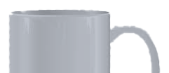
The Cup Is In

Slide 16

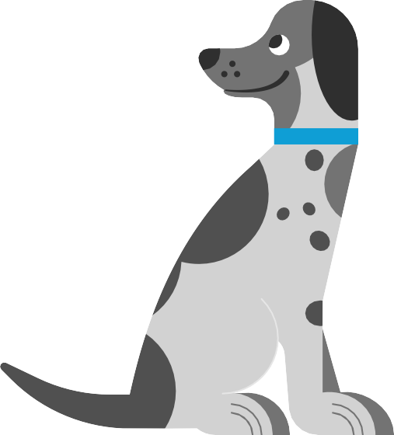
The Dog Is Up

Slide 17


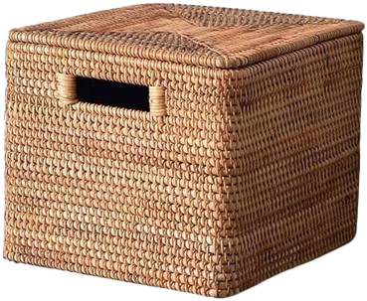
The Dog Is On

Slide 18


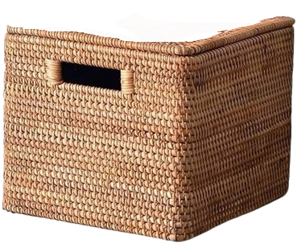
The Dog Is In

Slide 19

The Dot Is Up

Slide 20
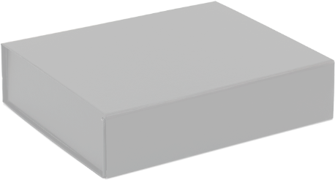

The Dot Is On

Slide 21

The Dot Is In

Slide 22
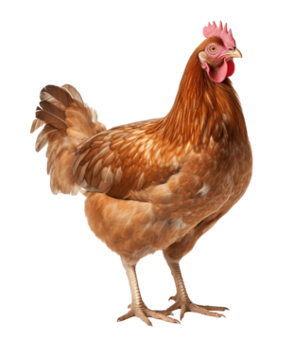
The Hen Is UP

Slide 23
The Hen Is On

Slide 24
The Hen Is In

Slide 25

The Log Is Up

Slide 26
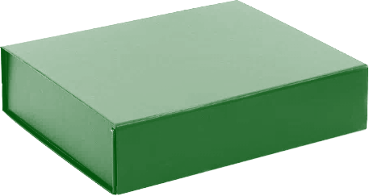
The Log Is On

Slide 27
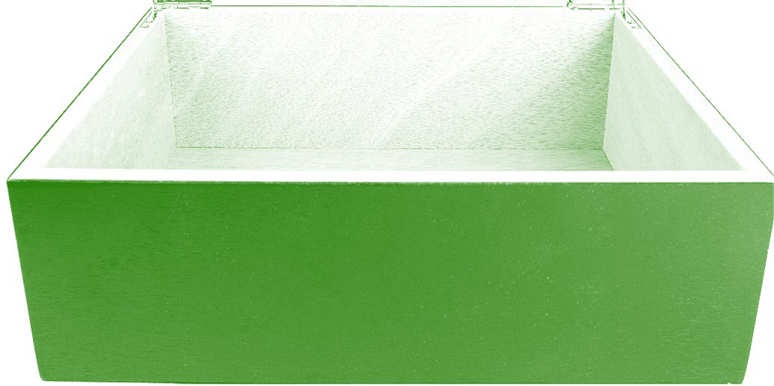

The Log Is In

Slide 28
The Map Is Up

Slide 29

The Map Is On

Slide 30
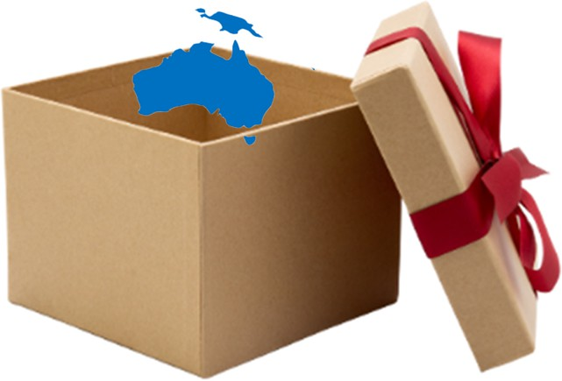
The Map Is In

Slide 31
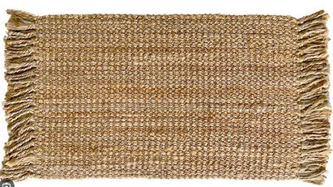
The Mat Is Up

Slide 32
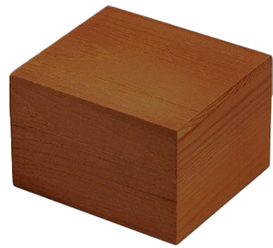
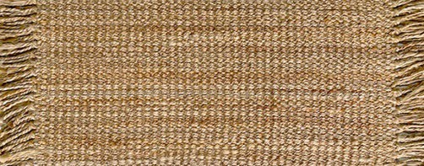
The Mat Is On

Slide 33
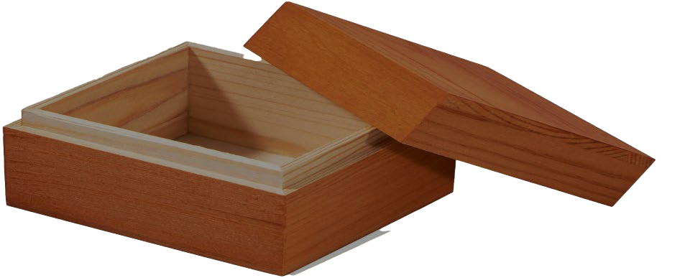
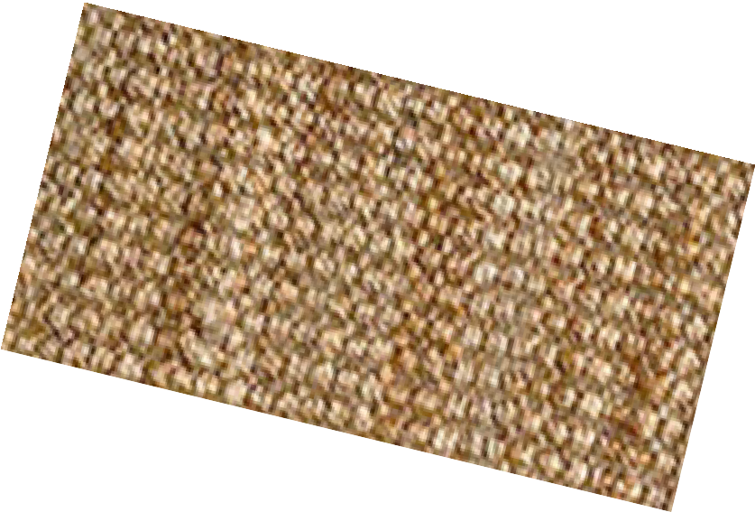
The Mat Is In

Slide 34
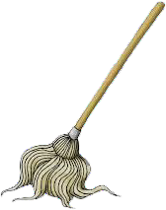
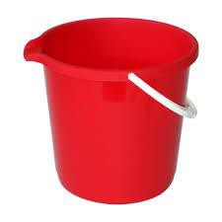
The Mop Is Up

Slide 35
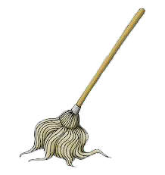
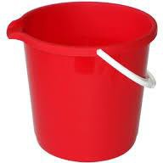
The Mop Is On

Slide 36
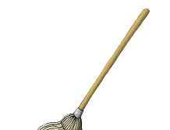
The Mop Is In

Slide 37

The Mud Is Up

Slide 38
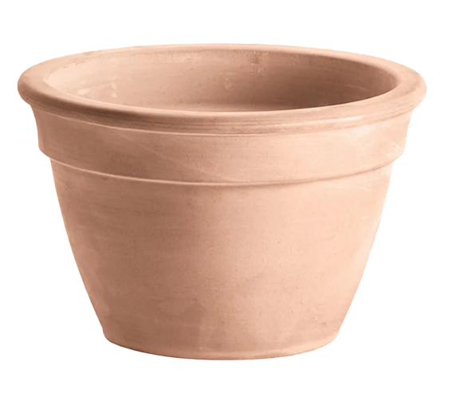
The Mud Is On

Slide 39

The Mud Is In

Slide 40
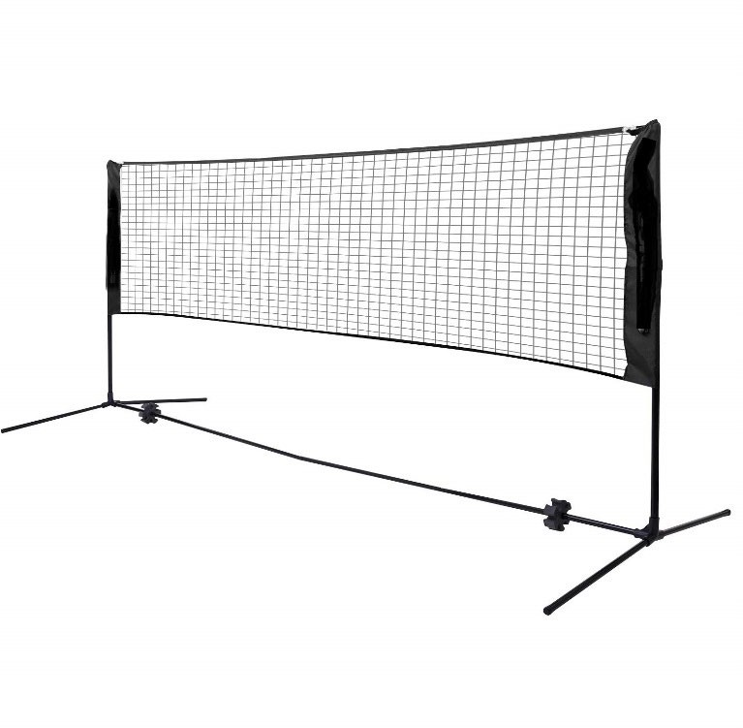
The Net Is Up

Slide 41
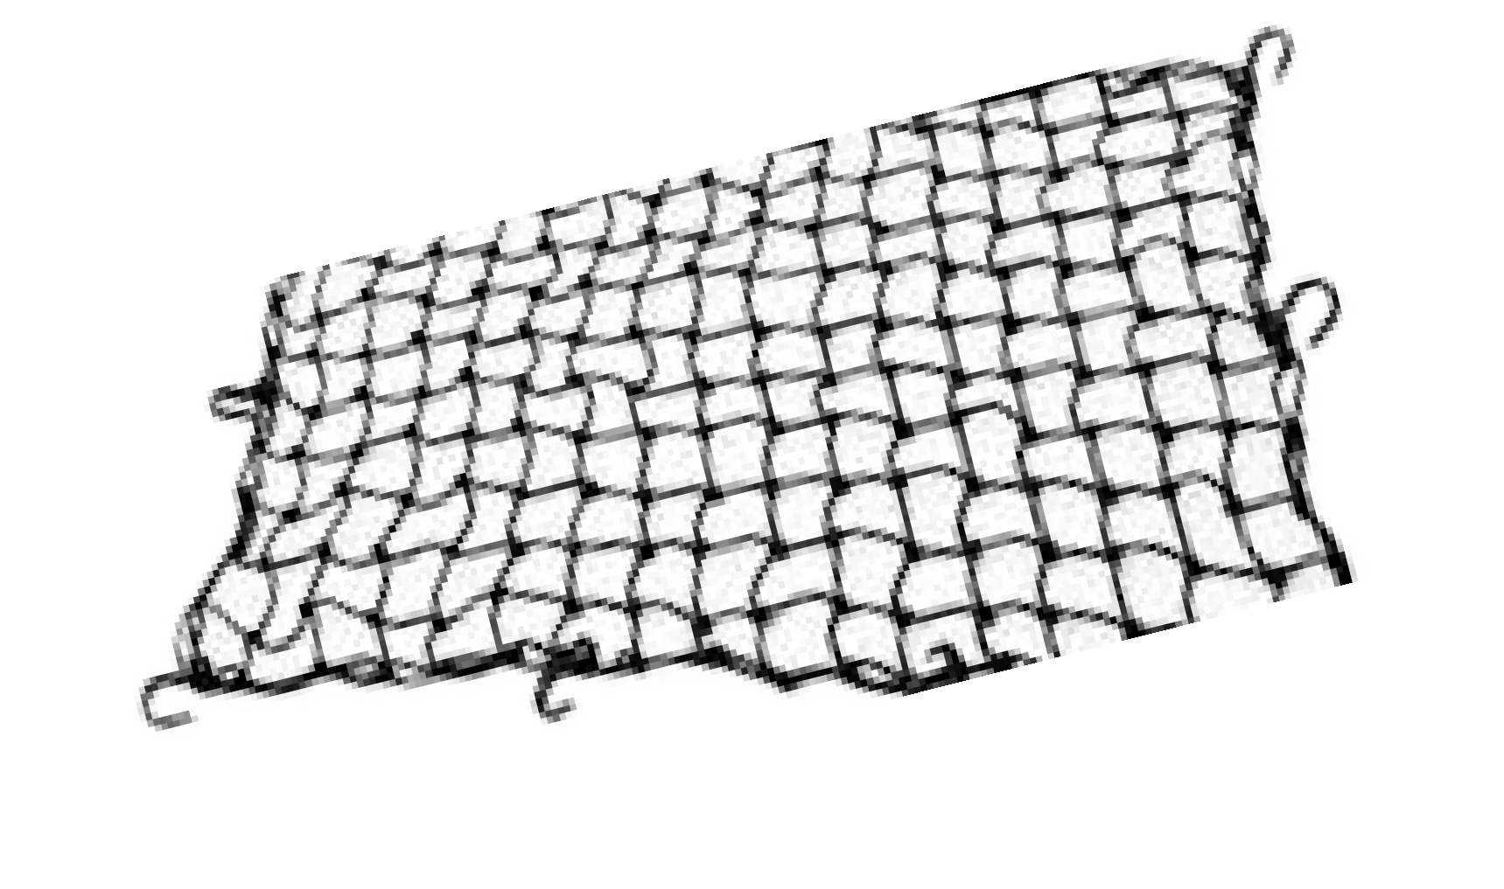
The Net Is On

Slide 42
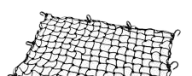
The Net Is In

Slide 43
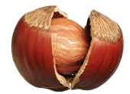
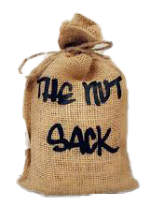
The Nut Is Up

Slide 44
The Nut Is On

Slide 45
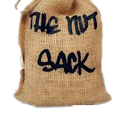
The Nut Is In

Slide 46
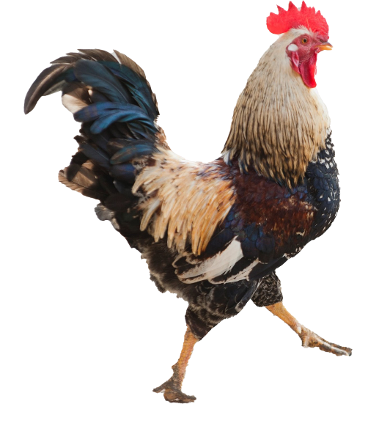
The Pet Is Up

Slide 47

The Pet Is On

Slide 48

The Pet Is In

Slide 49
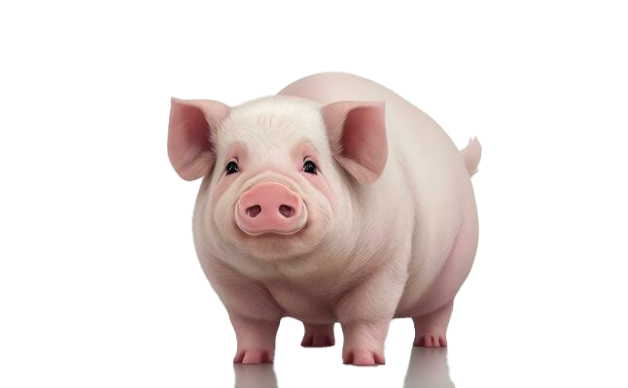
The Pig Is Up

Slide 50
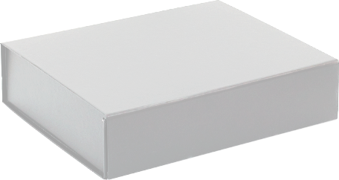
The Pig Is On

Slide 51
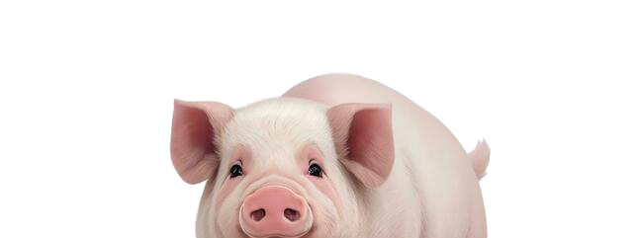
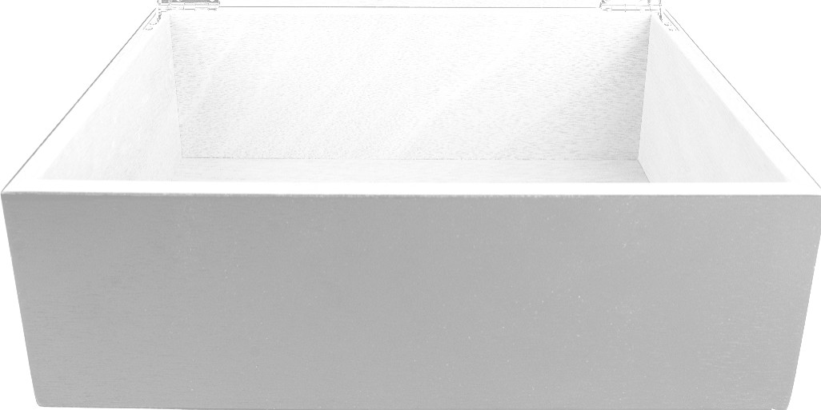
The Pig Is In

Slide 52

The Pin Is Up

Slide 53
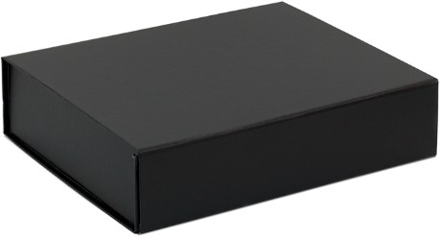
The Pin Is On

Slide 54
The Pin Is In

Slide 55
The Pot Is Up

Slide 56

The Pot Is On

Slide 57
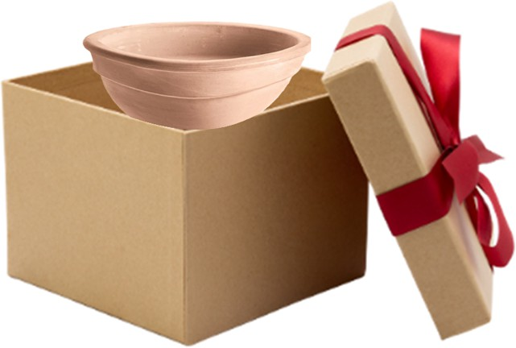
The Pot Is In

Slide 58
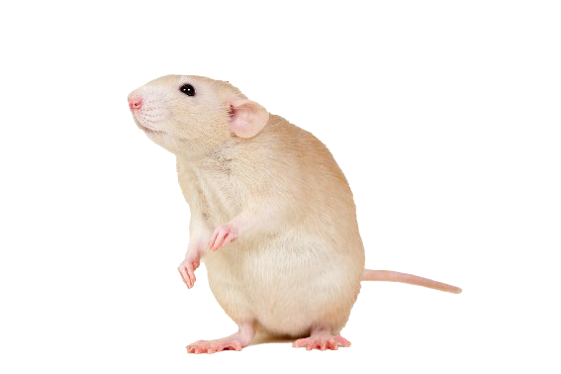
The Rat Is Up

Slide 59
The Rat Is On

Slide 60
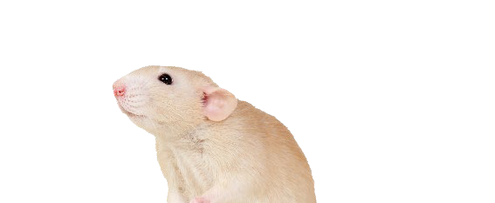
The Rat Is In

Slide 61


The Tap Is Up

Slide 62




The Tap Is On

Slide 63





The Tap Is In

Slide 64

The Tin Is Up

Slide 65

The Tin Is On

Slide 66


The Tin Is In

Slide 67

The VAN Is Up

Slide 68

The VAN Is On

Slide 69

The VAN Is In

Slide 70
The Web Is Up

Slide 71
The Web Is On

Slide 72

The Web Is In

